Slide 1
The Revised Mutation-Adjusted Risk Score (MARS-R) for predicting overall survival in patients with advanced systemic mastocytosis treated with midostaurin or avapritinib
Johannes Lübke,¹ Aaron Zakharyan,² Jason Gotlib,³ Daniel J. DeAngelo,⁴
Deepti H. Radia,⁵ Michael Deininger,⁶ Tracy I. George,⁷ Nicole Naumann,¹
Wolf-Karsten Hofmann,¹ Saša Dimitrijević,⁸ Juliana Schwaab,¹ Andreas Reiter¹
¹Department of Hematology and Oncology, University Hospital Mannheim, Heidelberg University, Mannheim, Germany; ²Blueprint Medicines Corporation, Cambridge, MA, USA; ³Division of Hematology, Stanford Cancer Institute/Stanford University School of Medicine, Stanford, CA, USA; ⁴Department of Medical Oncology, Dana-Farber Cancer Institute, Boston, MA, USA; ⁵Guy’s and St Thomas’ NHS Foundation Trust, London, UK; ⁶Deininger Lab, Versiti Blood Research Institute, Milwaukee, WI, USA; ⁷ARUP Laboratories, University of Utah, Salt Lake City, UT, USA; ⁸Blueprint Medicines (Switzerland) GmbH, Zug, Switzerland
EHA 2025, Milan

Slide 2
Evolving standard of care in AdvSM
Advanced systemic mastocytosis (AdvSM)
Rare myeloid neoplasm driven by KIT D816V in >95% of patients
Genetically complex disease, especially with associated hematologic neoplasm present and relevant additional somatic mutations (e.g., SRSF2, ASXL1, RUNX1, NRAS)
Approval
2009
Midostaurin
2016 2017
Approval ^{b}
Avapritinib
2016
Cladribine ª
CPKC412D2201:
Phase II study ^{c, 1}
N=116
2018
2022
EXPLORER:
Phase I study ^{d, 2}
N=86
PATHFINDER:
Phase II study ^{e, 3}
N=107
Initiation
Initiation
Initiation
2004-2008
2009
2010
2011
2012
2013
2014
2015
2016
2017
2018
2019
2020
2021
2022
2023
2024
ª Cladribine is not approved for the treatment of AdvSM. ^{b} Avapritinib is approved for any line by FDA and after at least 1 systemic therapy by EMA.
^{c} Data cutoff date July 9, 2013. ^{d} Data cutoff date May 27, 2020. ^{e} Data cutoff date June 23, 2020.
¹ Gotlib J, et al. N Engl J Med. 2016;374:2530-2541. ² DeAngelo DJ, et al. Nature Med. 2021;27:2183-2191. ³ Gotlib J, et al. Nature Med. 2021;27:2192-2199.

Slide 3
Study rationale for developing a new risk scoring system
Study rationale:
A.
Changing treatment landscape led to improved prognosis of patients with AdvSM.
Probability of overall survival
Probability of overall survival
Probability of overall survival
Cladribine ^{a, 1}
Midostaurin vs. cladribine ^{a, 2}
Avapritinib ^{b} vs. midostaurin / cladribine ^{a, 3}
ª Cladribine is not approved for the treatment of AdvSM. ^{b} Avapritinib is approved for any line by FDA and after at least 1 systemic therapy by EMA.
¹ Lübke J, et al. Ann Hematol. 2023;102:2077-2085. ² Lübke J, et al. J Clin Oncol. 2022;40:1783-1794. ³ Lübke J, et al. DGHO 2022. Abstract V52.

Slide 4
Study rationale for developing a new risk scoring system
Study rationale:
A.
Changing treatment landscape led to improved prognosis of patients with AdvSM.
Currently available AdvSM risk scoring systems (e.g., MARS ¹, IPSM ²) do not adequately reflect the current treatment landscape (MARS: treatment with midostaurin in <40%, with midostaurin and/or cladribine <50%, no treatment with avapritinib).
B.
Patient population of the MARS training set (N=231) ¹
Midostaurin: n=56 (24%)
Others (not specified) or none: n=120 (52%)
Midostaurin and cladribine sequentially: n=35 (15%)
Cladribine: n=20 (9%)
IPSM, International Prognostic Scoring System for Mastocytosis; MARS, mutation-adjusted risk score.
¹ Jawhar M, et al. J Clin Oncol. 2019;37:2846-2856. ² Sperr WR, et al. Lancet Haemtol. 2019;6:e638-e649.

Slide 5
Study rationale for developing a new risk scoring system
Study rationale:
A.
Changing treatment landscape led to improved prognosis of patients with AdvSM.
Currently available AdvSM risk scoring systems (e.g., MARS ¹, IPSM ²) do not adequately reflect the current treatment landscape (MARS: treatment with midostaurin in <40%, with midostaurin and/or cladribine <50%, no treatment with avapritinib).
B.
Current AdvSM risk scoring systems (e.g., MARS ¹, IPSM ²) rely solely on categorical variables, which may oversimplify complex data and fail to capture important relationships - such as linear, exponential, or other patterns - between risk factors and outcomes.
C.
IPSM, International Prognostic Scoring System for Mastocytosis; MARS, mutation-adjusted risk score.
¹ Jawhar M, et al. J Clin Oncol. 2019;37:2846-2856. ² Sperr WR, et al. Lancet Haemtol. 2019;6:e638-e649.

Slide 6
Study objective
Study rationale:
A.
Changing treatment landscape led to improved prognosis of patients with AdvSM.
Currently available AdvSM risk scoring systems (e.g., MARS ¹, IPSM ²) do not adequately reflect the current treatment landscape (MARS: treatment with midostaurin in <40%, with midostaurin and/or cladribine <50%, no treatment with avapritinib).
B.
Current AdvSM risk scoring systems (e.g., MARS ¹, IPSM ²) rely solely on categorical variables, which may oversimplify complex data and fail to capture important relationships - such as linear, exponential, or other patterns - between risk factors and outcomes.
C.
Study objective:
To develop the Revised Mutation-Adjusted Risk Score (MARS-R), a continuous-scale OS risk scoring system for patients with KIT D816V-positive AdvSM treated with midostaurin or avapritinib, independent of WHO-defined subgroups.
ICC, International Consensus Classification; IPSM, International Prognostic Scoring System for Mastocytosis; MARS, mutation-adjusted risk score; OS, overall survival; WHO, World Health Organization.
¹ Jawhar M, et al. J Clin Oncol. 2019;37:2846-2856. ² Sperr WR, et al. Lancet Haemtol. 2019;6:e638-e649.

Slide 7
Patient cohorts
Inclusion criteria:
Diagnosis: Confirmed AdvSM according to the WHO ¹ classification
Genetics: Presence of the KIT D816V mutation ²
Treatment history: Treatment with either midostaurin or avapritinib
Midostaurin and avapritinib cohorts were balanced regarding WHO diagnosis, existing risk scoring systems, and C-findings.
ª Data cutoff date 2024. ^{b} Data cutoff date January 19, 2023. ^{c} Data cutoff date September 15, 2023.
AHN, associated hematologic neoplasm; ASM, aggressive systemic mastocytosis; CEL, chronic eosinophilic leukemia; CMML, chronic myelomonocytic leukemia; HR, high risk; IR, intermediate risk; LR, low risk; max., maximum; MDS, myelodysplastic neoplasms; MPN, myeloproliferative neoplasms; WHO, World Health Organization.
¹ Khoury JD, et al. Leukemia. 2022;36:1703-1719. ² Naumann N, et al. Cancers (Basel). 2024;16:593. ³ DeAngelo DJ, et al. Nature Med. 2021;27:2183-2191. ⁴ Gotlib J, et al. Nature Med. 2021;27:2192-2199. ⁵ Jawhar M, et al. J Clin Oncol. 2019;37:2846-2856. ⁶ Sperr WR, et al. Lancet Haemtol. 2019;6:e638-e649.

Slide 8
Selection of clinical and genetic candidate risk variables
Continuously encoded
Categorical encoded
AdvSM (Training cohort)
1
2
4
2
Age
Serum tryptase
Sex
1
MARS (N=231, 2019) ¹
1
2
3
2
Hemoglobin
BM Mast cell infiltration
Skin involvement
2
IPSM (N=259, 2019) ²
1
2
4
3
4
1
3
4
Platelet count
Alkaline phosphatase
ASXL1
2
Leukocyte count
Albumin
EZH2
1
3
4
SM (Training cohort)
ANC
KIT D816V EAB/VAF in PBª
RUNX1
1
3
GPSM (N=422, 2021) ³
Monocyte count
SRSF2/ASXL1/RUNX1 ^{b}
SETBP1
1
3
4
MAPS (N=145, 2018) ⁴
Eosinophil count
Composite var of mut^{c}
SRSF2
Stepwise selection by Cox multivariable model
ª KIT D816V was measured on RNA or DNA level in midostaurin- or avapritinib-treated patients, respectively.
^{b} The number of mutations within the SRSF2/ASXL1/RUNX1 gene panel was tested.
^{c} A composite variable consisting of the number of additional somatic mutations was tested.
ANC, absolute neutrophil count; BM, bone marrow; EAB, expressed allele burden; GPSM, global prognostic score for mastocytosis; MAPS, Mayo alliance prognostic system for mastocytosis; mut, mutations; PB, peripheral blood; VAF, variant allele burden; var, variable.
¹ Jawhar M, et al. J Clin Oncol. 2019;37:2846-2856. ² Sperr WR, et al. Lancet Haemtol. 2019;6:e638-e649. ³ Munoz-Gonzalez JI, et al. Lancet Haematol. 2021;8:e193-e204 . ⁴ Pardanani A, et al. Blood Adv. 2018;2:2964-2972.

Slide 9
Development of the Revised Mutation-Adjusted Risk Score (MARS-R)
Continuously scaled
Reference | Range ª | Favorable | Unfavorable | HR (95% Wald CI) | Coefficients (w_{j})
- | f(x)=max(38, min(x,86)) |  |  | 1.051 (1.028-1.073) | w_{age}
- | f(x)=max(x,9.0) |  |  | 1.294 (1.070-1.565) | W_{monocytes} ^{b}
- | f(x)=max(x,250) |  |  | 0.998 (0.996-0.999) | w_{platelets}
Age (years)
1.1
Monocyte count (x10⁹/L)
1.3
Platelet count (x10⁹/L)
0.9
0.1
1
10
CI, confidence interval; HR, hazard ratio; max, maximum; min, minimum.
ª Truncation at 38 and 86 years for age (1st and 99th percentile), at 9 x10⁹/L for monocyte count (99th percentile) and at 250 x10⁹/L for platelet count (80th percentile).
^{b} The coefficient was normalized.
^{c} MARS-R was calculated as a normalized linear combination, where each observed variable x_{j} for a given patient is weighted by a coefficient w_{j}. The final sum is normalized.

Slide 10
Development of the Revised Mutation-Adjusted Risk Score (MARS-R)
Continuously scaled
Reference | Range ª | Favorable | Unfavorable | HR (95% Wald CI) | Coefficients (w_{j})
- | f(x)=max(38, min(x,86)) |  |  | 1.051 (1.028-1.073) | w_{age}
- | f(x)=max(x,9.0) |  |  | 1.294 (1.070-1.565) | W_{monocytes} ^{b}
- | f(x)=max(x,250) |  |  | 0.998 (0.996-0.999) | w_{platelets}
Mutated | - |  |  | 1.723 (1.122-2.645) | w_{ASXL1}
Mutated | - |  |  | 1.700 (1.102-2.622) | w_{RUNX1}
Mutated | - |  |  | 2.550 (1.238-5.252) | w_{SETBP1}
Female | - |  |  | 0.536 (0.354-0.812) | w_{sex}
Presence | - |  |  | 0.661 (0.440-0.992) | w_{skin}
Categorical scaled
Age (years)
1.1
Monocyte count (x10⁹/L)
1.3
Platelet count (x10⁹/L)
0.9
ASXL1
1.7
RUNX1
1.7
SETBP1
2.6
Sex
0.5
Skin involvement
0.7
0.1
1
MARS-R = ${norm(∑}_{ variables j }w_{j} x_{j})$ ^{c}
10
CI, confidence interval; HR, hazard ratio; max, maximum; min, minimum.
ª Truncation at 38 and 86 years for age (1st and 99th percentile), at 9 x10⁹/L for monocyte count (99th percentile) and at 250 x10⁹/L for platelet count (80th percentile).
^{b} The coefficient was normalized.
^{c} MARS-R was calculated as a normalized linear combination, where each observed variable x_{j} for a given patient is weighted by a coefficient w_{j}. The final sum is normalized.

Slide 11
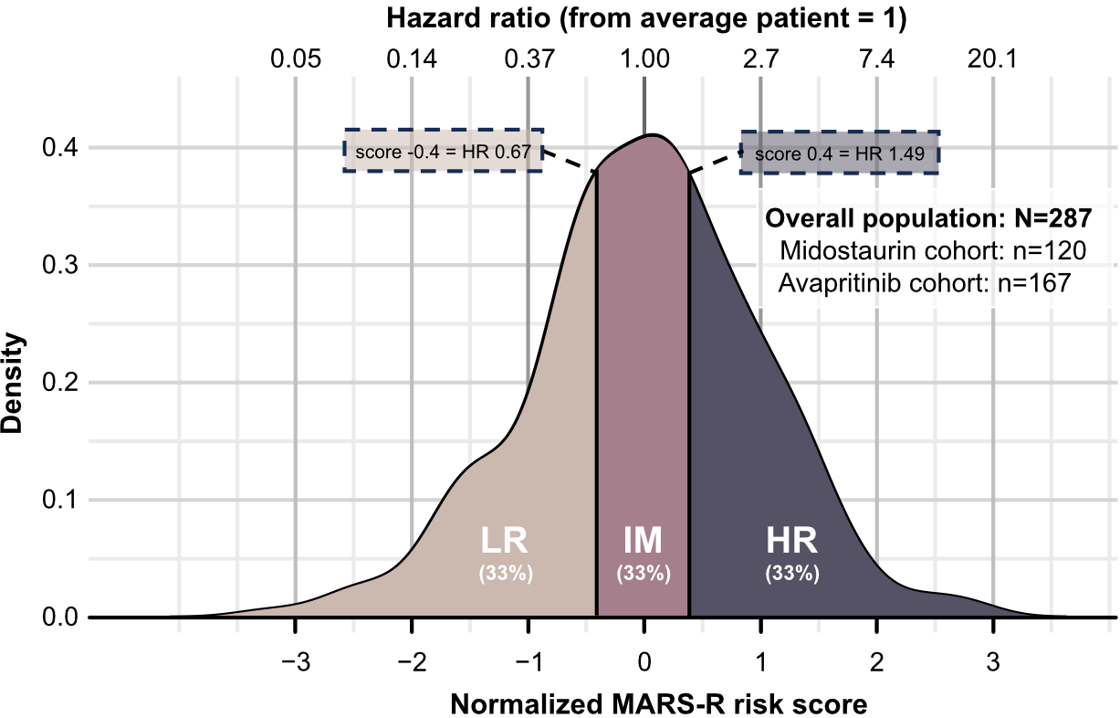
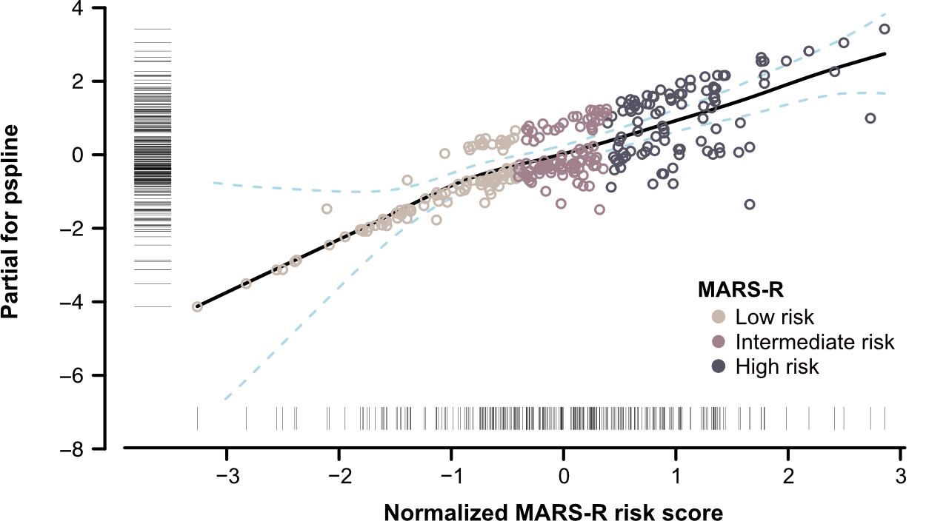
The MARS-R is individualizing risk assessment in AdvSM
The MARS-R provides a continuous score with a virtually unique value per patient
Negative or positive scores reflect worse or better OS compared to the average-risk AdvSM patient
Hazard ratio (from average patient = 1)
Density
Partial for pspline
MARS-R
Normalized MARS-R risk score
Normalized MARS-R risk score
Smoothing splines modeling the functional MARS-R risk representation shows a consistent linear progression across the entire scale
Equal percentile-based cutoffs to the continuous MARS-R scale were applied to generate three different risk categories

Slide 12
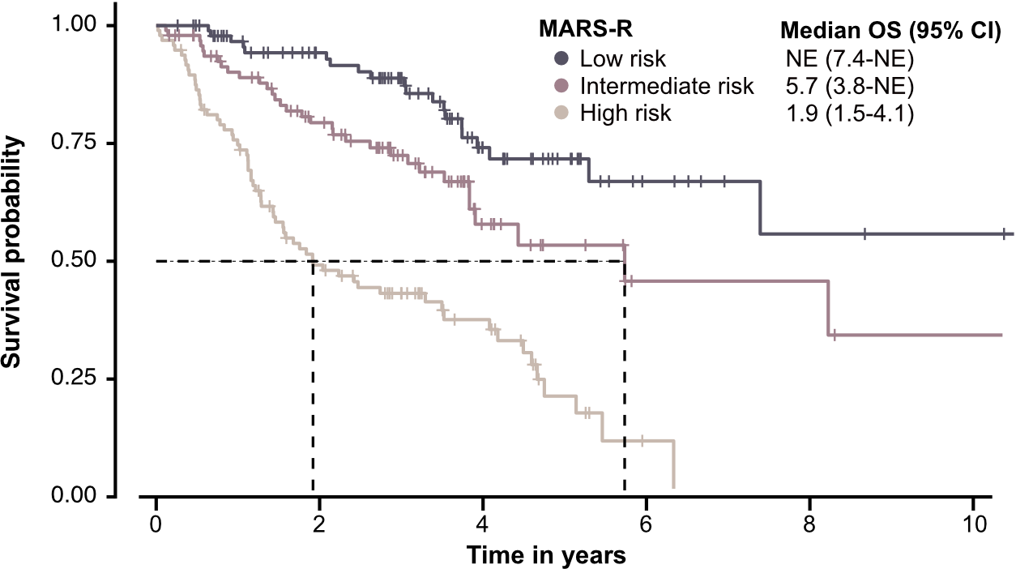
Overall survival according to MARS-R categories
MARS-R categories
By year
LR | IR | HR
97 | 90 | 75
94 | 79 | 49
89 | 72 | 43
74 | 58 | 38
72 | 53 | 21
67 | 46 | 12
67 | 46 | -
56 | 46 | -
56 | 34 | -
56 | 34 | -
MARS-R
Median OS (95% CI)
1
2
3
4
Survival probability
Overall survival (%)
5
6
7
8
9
Time in years
10
HR, high risk; IR, intermediate risk; LR, low risk; NE, not estimable.

Slide 13
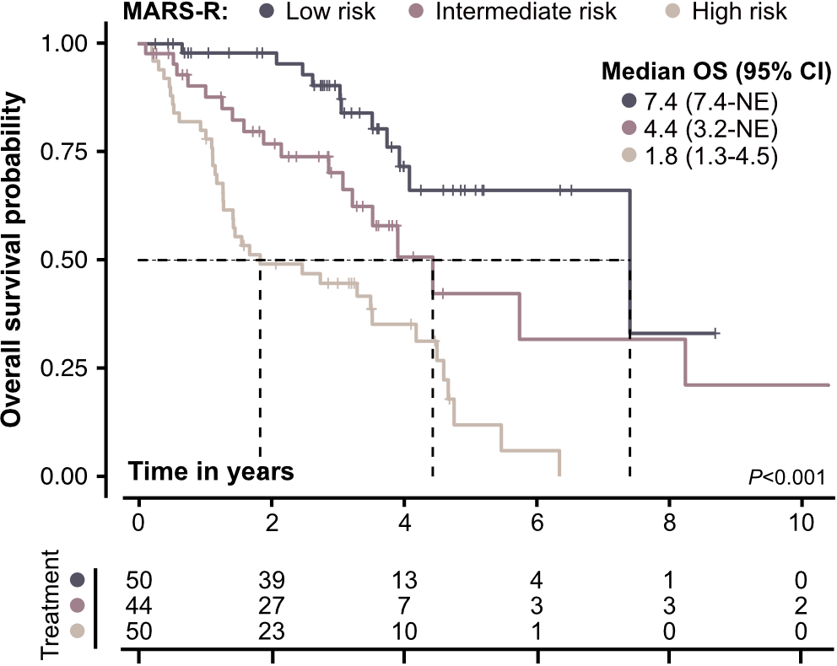
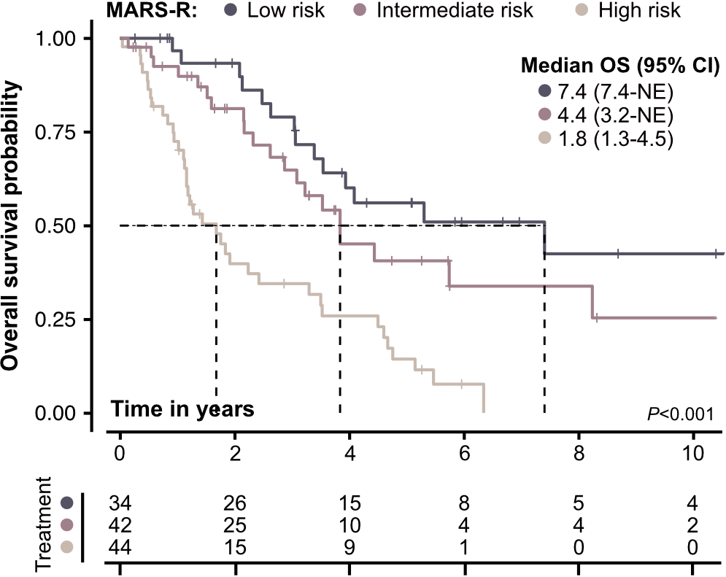
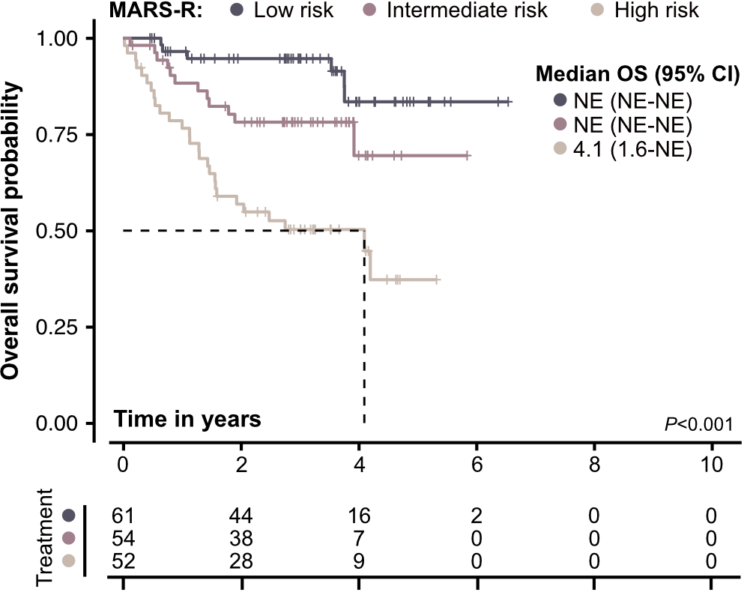
The MARS-R has been internally validated
Validation cohort (50% random split)
Midostaurin treatment (GREM)
Avapritinib treatment
Overall survival (%)
Overall survival (%)
By year
1
2
3
4
5
By year
1
2
3
4
5
The MARS-R can be independently applied to KIT D816V-positive AdvSM patients at time of midostaurin or avapritinib start.
LR | 97 | 93 | 79 | 60 | 56
IR | 92 | 81 | 65 | 45 | 41
HR | 72 | 40 | 35 | 26 | 14
LR | 97 | 95 | 95 | 83 | 83
IR | 88 | 78 | 78 | 69 | 69
HR | 77 | 57 | 50 | 50 | 37
MARS-R
MARS-R

Slide 14
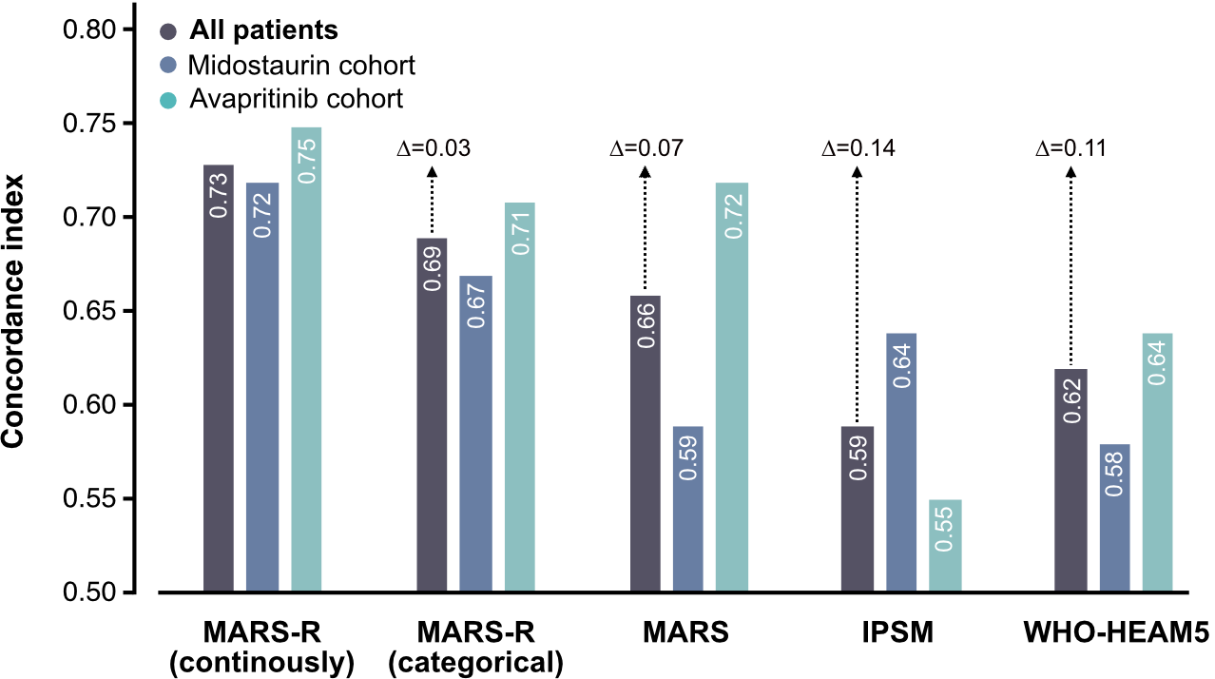
The MARS-R is a better discriminator of the risk
Concordance index
The MARS-R consistently outperforms other prognostic models, independent of treatment with midostaurin and/or avapritinib.
MARS-R (continuous)
MARS-R (categorical)
MARS ¹
IPSM ²
WHO ^{a,3}
^{a, 3}
ª Patients were grouped into 4 different subgroups: ASM, MCL, SM-AHN, and MCL-AHN. The ∆ symbol denotes the difference in Harrell’s Concordance index between the continuously scaled MARS-R and alternative models.
¹ Jawhar M, et al. J Clin Oncol. 2019;37:2846-2856. ² Sperr WR, et al. Lancet Haemtol. 2019;6:e638-e649. ³ Khoury JD, et al. Leukemia. 2022;36:1703-1719.

Slide 15
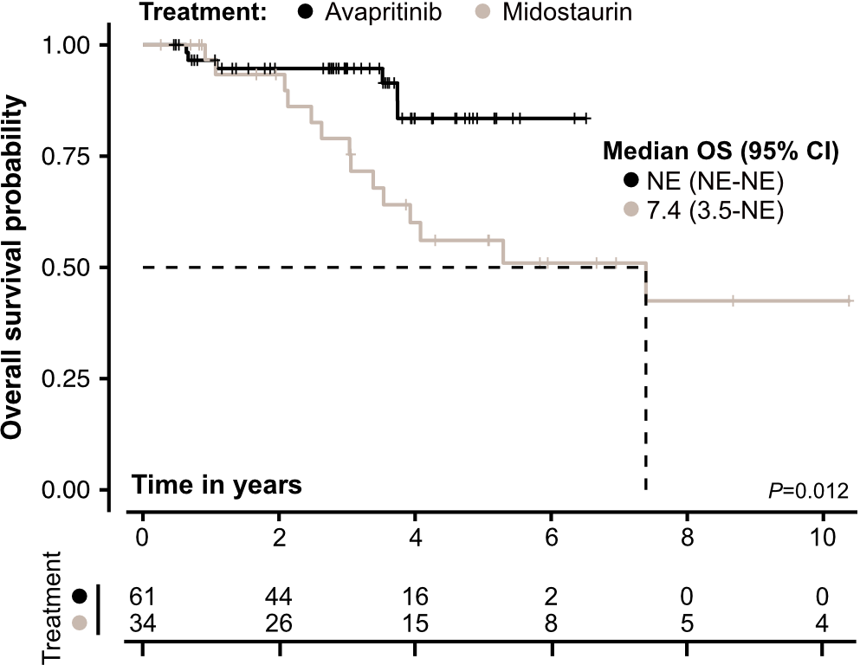
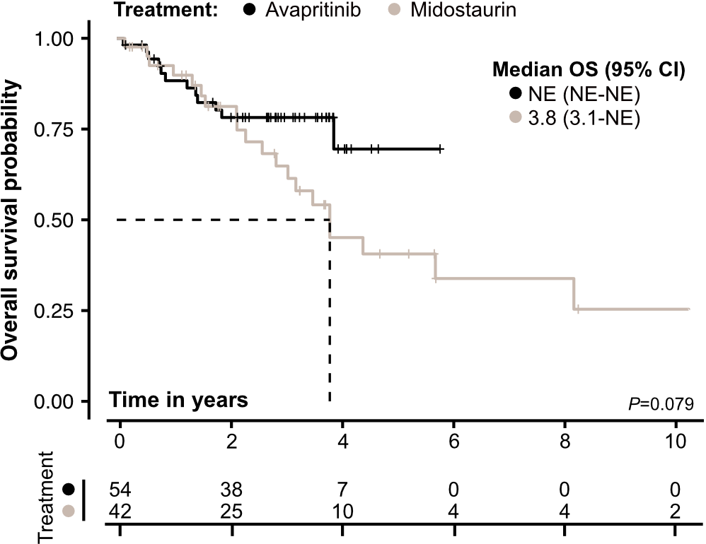
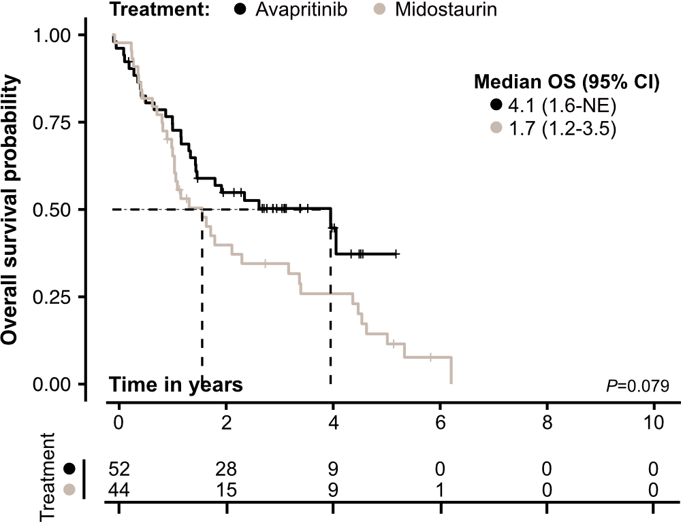
Avapritinib demonstrates longer OS vs midostaurin in all 3 MARS-R risk groups
Low risk
Intermediate risk
High risk
Overall survival (%)
Overall survival (%)
Overall survival (%)
By year
1
2
3
4
5
By year
1
2
3
4
5
By year
1
2
3
4
5
Ava | 97 | 95 | 95 | 83 | 83
Mido | 97 | 93 | 79 | 60 | 56
Ava | 88 | 78 | 78 | 70 | 70
Mido | 92 | 81 | 65 | 45 | 41
Ava | 77 | 57 | 50 | 50 | 37
Mido | 72 | 40 | 35 | 26 | 14
Treatment
Treatment
Treatment

Slide 16
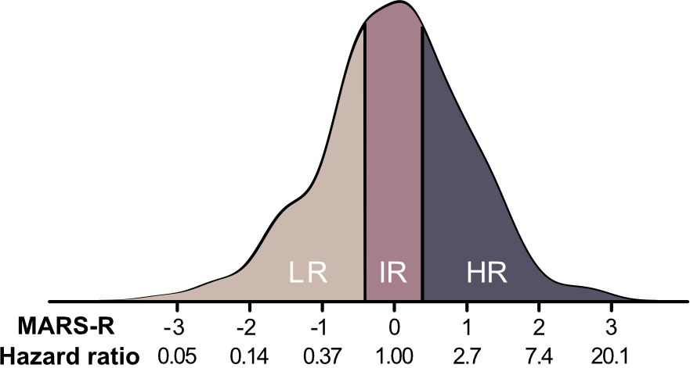
Conclusions
Prognostication by MARS-R
The MARS-R was developed using both categorical and continuous variables from patients treated with the KIT inhibitors midostaurin or avapritinib
Patients can be categorized into 3 distinct risk categories
This new model offers advantages over the existing models:
A continuous score that provides an individual value for each patient
Captures the continuum of OS risk in patients with AdvSM
Highly reproducible and applicable to patients receiving midostaurin or avapritinib
In the era of KIT inhibitor therapy, the MARS-R can serve as an important new tool helping treatment decisions for KIT D816V-positive patients based on the risk score
Continuous
score
Summary risk metric:
Median OS (95% CI) in
- Low risk (LR): NE (7.4-NE) years
- Intermediate risk (IR): 5.7 (3.8-NE) years
- High risk (HR): 1.9 (1.5-4.1) years
Categorical
score
LR vs. IR vs. HR

Slide 17
Acknowledgments
We thank the patients and their families for making this study possible
We thank the investigators and clinical trial teams for their contributions to the studies
The EXPLORER and PATHFINDER studies were funded by Blueprint Medicines Corporation, Cambridge, MA
Medical writing and editorial support was provided by William Sinkins, PhD, of HCG, funded by Blueprint Medicines Corporation, Cambridge, MA, according to current policies established by the International Committee of Medical Journal Editors and Good Publication Practice guidelines. The sponsor reviewed and provided feedback on the presentation; however, the authors had full editorial control and provided final approval of all content

